Slide 1

Air Quality Time Series Hyperparameters optimization using Evolutionary Computation methods
Authors: Batyr K., Ryan K., Prerak P., Devson B.
Objective:
Develop a highly optimized time series prediction model for air quality data using Evolutionary Strategies (ES) and the DEAP library.

Slide 2
Abstract
This study evaluates the performance of LSTM/GRU-based neural networks for predictive modeling, utilizing Evolutionary Computation methods, including Evolution Strategies (ES) and the DEAP framework, to optimize hyperparameters. This study focuses on predicting Total Nitrogen Oxides (NOx), with the goal of decreasing an RMSE metric.
The lowest loss of 40.99 was achieved with 115 RNN units + 3 DNN layers(64, 128, 27 neurons), 12 lags, a learning rate of 0.001 using ES(N+M). These results demonstrate the effectiveness of fine-tuning hyperparameters for minimizing loss.

Slide 3
Optimization Strategy - Evolutionary Computation
Why Evolutionary Computation?
Evolution Strategies (ES) and DEAP library can adaptively search for optimal hyperparameters and network structures.
Allows for comprehensive exploration and exploitation of the search space for better model performance.
Optimization Targets:
Hyperparameters: Learning rate, batch size, number of hidden layers, neuron counts.
Structural Configuration: Fine-tuning the arrangement of layers to maximize efficiency.

Slide 4
Evolutionary Computation Methods – ES and DEAP
Evolution Strategies (ES):
A family of optimization algorithms that evolves a population of solutions based on mutation and selection.
Beneficial for avoiding local minima and reaching global optimal solutions.
DEAP Library:
Python framework for evolutionary algorithms.
Provides a toolkit for genetic algorithms, ES, and other optimization methods, allowing efficient experimentation and customization.

Slide 5
Introduction
The accurate prediction of Total Nitrogen Oxides (NOx) emissions is a critical task in environmental monitoring and air quality management. Predictive modeling, particularly using Long Short-Term Memory (LSTM) networks, has demonstrated significant promise for time-series forecasting in atmospheric science [1]. Recent studies, such as those by Zhang et al. [2] and Kumar et al. [3], have shown the effectiveness of deep learning models, including LSTM and GRU, in capturing complex temporal dependencies in pollutant concentration data. However, optimizing these models remains a challenge, as hyperparameters significantly influence model accuracy and computational efficiency.
This research utilizes Evolutionary Computation techniques, specifically Evolution Strategies (ES) and the DEAP framework, to optimize LSTM hyperparameters. These methods allow systematic exploration of hyperparameter spaces, outperforming traditional grid or random search methods in terms of efficiency and effectiveness [4, 5].

Slide 6
Research Tools and Environment
Experiments use Python with TensorFlow/Keras for LSTM implementation, DEAP for evolutionary optimization, and NumPy/Pandas for data handling. Models run on Google Colab, with DEAP applying Evolution Strategies to optimize key hyperparameters.
Goals of the Research
The primary goal of this study is to decrease a Root Mean Square Error (RMSE) for predicting NOx levels. To this end, the research explores the potential of Evolutionary Computation methods in fine-tuning LSTM models for time-series forecasting. By combining advanced deep learning techniques with evolutionary optimization, the study aims to enhance predictive accuracy while maintaining computational efficiency.

Slide 7
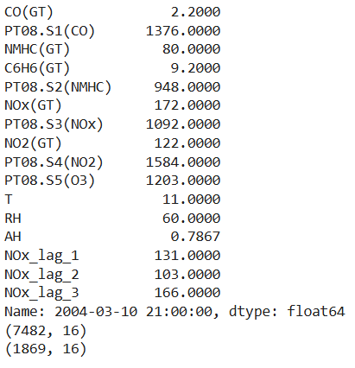
Dataset Description
The UCI Air Quality Dataset provides hourly air quality data, including CO, benzene, temperature, relative humidity, and NOx. After preprocessing, NOx is used as the target variable, with other features as predictors. Data is split into 80% training and 20% testing sets.
UCI Machine Learning Repository. Air Quality Dataset. Available at: https://archive.ics.uci.edu/ml/datasets/air+quality

Slide 8
Methods with subsections
Basic Deep Learning methods
LSTM/GRU model
ES(1+1) with 1/5 rule method(Hyper Parameter Optimization) – Batyr
Basic: Number of neurons, Learning rate, Batch size, Activation function, and Optimizer
Specific: Number of ‘Lags’ and Number of Timesteps
ES(N + M) – Ryan and Devson
DEAP – Batyr and Prerak

Slide 9
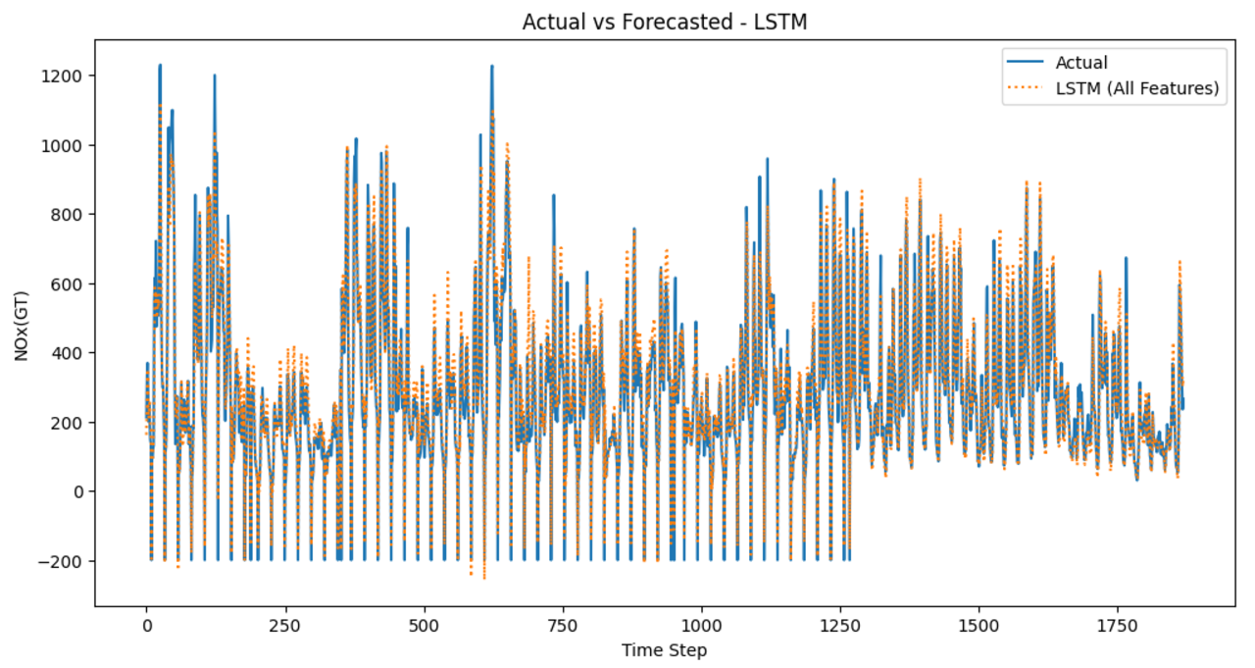
Initial Setup and Baseline Model
Dataset: Air quality data with pollutants such as NOx, CO, and NO2 levels, using a multivariate approach for accurate forecasting.
Baseline Model: Initial model setup with Long Short-Term Memory (LSTM) and Gated Recurrent Unit (GRU) networks.
Challenges Noted:
Difficulty in capturing long-term dependencies and seasonal patterns.
Baseline results demonstrate moderate loss, providing an opportunity for optimization
Root Mean Squared Error (RMSE): 62.48694643385209

Slide 10
Model: ES(1+1) with 1/5 rule method(Hyper Parameter Optimization) – Batyr Basic: Number of neurons, Learning rate, Batch size, Activation function, and Optimizer
Trial | RNN type | # neurons | Learning rate | Batch size | Activation function | Optimizer | Loss | Iterations
1 | LSTM | 85 | 0.001000 | 17 | elu | Adam | 59.887450 | 1
2 | LSTM | 188 | 0.001000 | 17 | elu | Adam | 57.017130 | 18
3 | LSTM | 146 | 0.001000 | 16 | relu | Adam | 59.937120 | 12
4 | LSTM | 211 | 0.001000 | 18 | relu | Adam | 59.924760 | 12
5 | LSTM | 268 | 0.001000 | 16 | relu | Adam | 55.978120 | 19
1 | GRU | 246 | 0.001000 | 18 | elu | Adam | 59.993050 | 17
2 | GRU | 282 | 0.001000 | 16 | elu | Adam | 53.922060 | 17
3 | GRU | 241 | 0.001000 | 16 | elu | Adam | 57.075460 | 2
4 | GRU | 263 | 0.001000 | 16 | relu | Adam | 58.495670 | 2
5 | GRU | 261 | 0.001000 | 16 | elu | Adam | 57.972760 | 5

Slide 11
Model: ES(1+1) with 1/5 rule method(Hyper Parameter Optimization) – Batyr Specific: Number of ‘Lags’ and Number of Timesteps
Trial | RNN type | # neurons | # lags | Learning rate | Batch size | Activation function | Optimizer | Loss | Iterations
1 | LSTM | 332 | 4 | 0.001000 | 15 | relu | Adam | 53.793950 | 10
2 | LSTM | 281 | 3 | 0.001000 | 15 | elu | RMSprop | 58.379630 | 12
3 | LSTM | 250 | 2 | 0.001000 | 17 | relu | Adam | 59.572110 | 6
4 | LSTM | 300 | 3 | 0.001000 | 15 | elu | RMSprop | 57.356700 | 16
5 | LSTM | 321 | 2 | 0.001000 | 15 | relu | Adam | 56.737870 | 4
1 | GRU | 283 | 3 | 0.001000 | 10 | elu | RMSprop | 59.092310 | 7
2 | GRU | 287 | 6 | 0.001000 | 8 | elu | RMSprop | 59.303440 | 2
3 | GRU | 250 | 3 | 0.001000 | 11 | elu | RMSprop | 56.833080 | 7
4 | GRU | 328 | 3 | 0.001000 | 8 | elu | RMSprop | 58.476100 | 2
5 | GRU | 286 | 3 | 0.001000 | 8 | elu | RMSprop | 59.760440 | 4

Slide 12
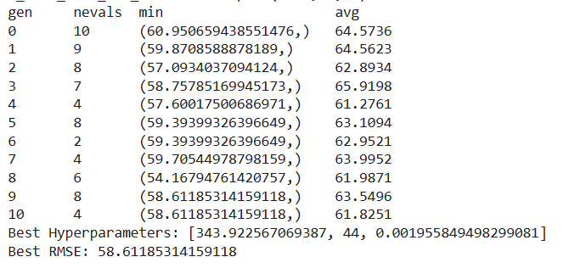
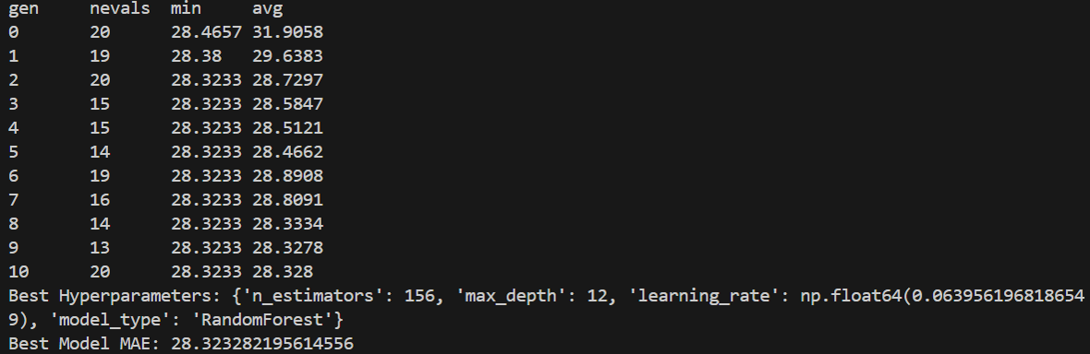
Model: DEAP (Hyper Parameter Optimization) Basic: Number of neurons, Learning rate, Batch size
Batyr K.
Prerak P.

Slide 13
Model: ES(N+M) (Hyper Parameter Optimization) – Ryan and Devson Basic: Number of neurons, Number of lags, Learning rate, N & M values
Trial | RNN type | # TimeSeries Units | # 1 layer Units | # 2 layer Units | # 3 layer Units | # lags | Learning rate | Loss
1 | LSTM | 115 | 64 | 128 | 27 | 12 | 0.0010 | 40.985500
2 | GRU | 36 | 64 | 98 | 32 | 12 | 0.0993 | 47.710293
3 | LSTM | 110 | 64 | - | - | 12 | 0.0494 | 42.379280

Slide 14
References
Hochreiter, S., & Schmidhuber, J. (1997). Long Short-Term Memory. Neural Computation.
Zhang, X., et al. (2020). Deep learning models for air quality prediction: A comprehensive review. Atmospheric Environment.
Kumar, A., et al. (2021). Predicting air pollutant concentrations using deep recurrent neural networks. Environmental Science and Pollution Research.
Schwefel, H.-P. (1995). Evolution Strategies: A Comprehensive Introduction. Springer-Verlag.
Fortin, F.-A., et al. (2012). DEAP: Evolutionary algorithms made easy. Journal of Machine Learning Research.
UCI Machine Learning Repository. Air Quality Dataset. Available at: https://archive.ics.uci.edu/ml/datasets/air+quality

